Slide 1
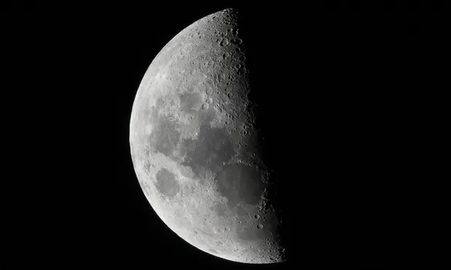
Nasa is installing internet on the moon

Slide 2
Couple in California name baby with emoji

Slide 3
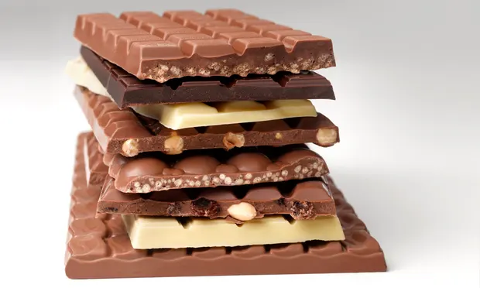
German street covered in chocolate after leak from chocolate factory

Slide 4
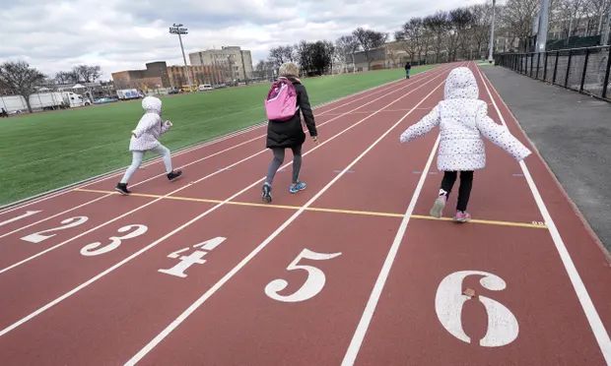
School bans parents from sports day for bad behaviour

Slide 5
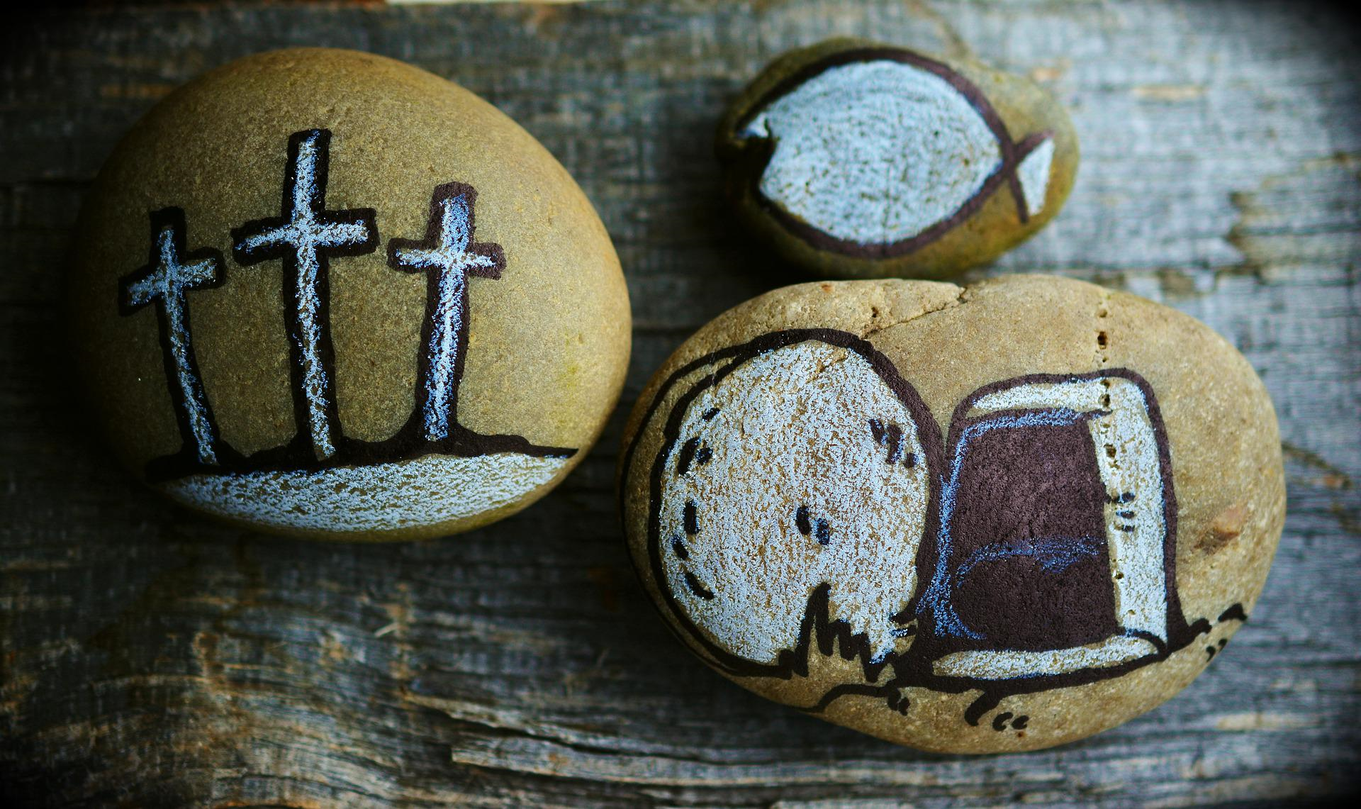
Jesus rose from the dead

